Slide 1
Facial GeoLock: Next-Level Attendance Authentication with Location Tracking
Secure Software Design and Programming
(Professor Lisa Luo)

Slide 2
Squad 7
Saaketh Matta - G01413120
Sushmitha Konduru - G01456225
Sai Subbarao Gunisetty - G01408517
Sushrutha Reddy Anireddy - G01446984

Slide 3
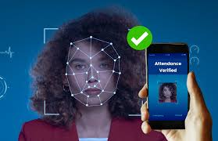
WELCOME TO THE WORLD OF FACIAL GEOLOCK
1
Advanced Attendance Authentication System
2
Multi Factor Authentication
3
Prevents Buddy Punching
4
Location Tracking

Slide 4
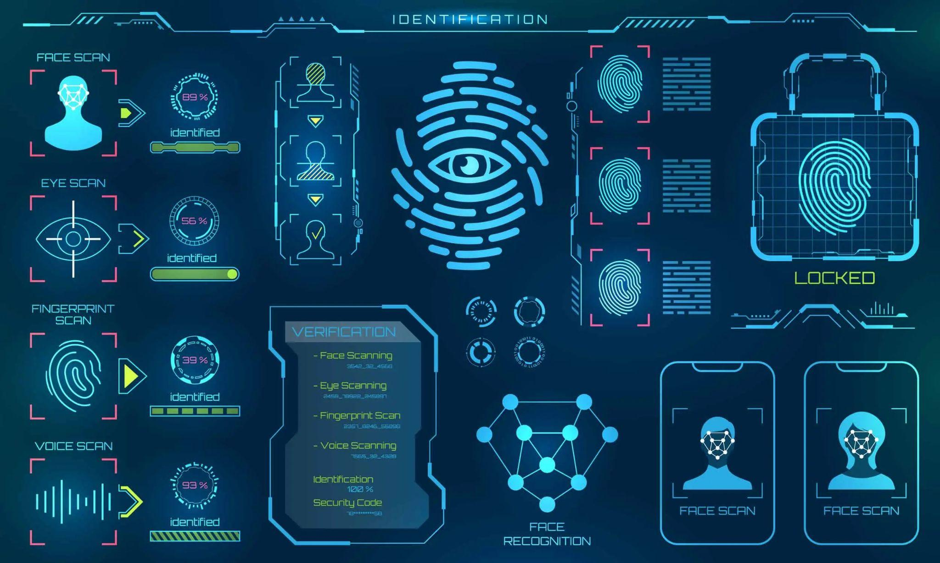
BIOMETRICS
Unique physical and behavioral characteristics.
History: => 1960’s - Pattern recognition and Computer Vision. => Woodrow Wilson Bledsoe - system- photographs. => 1990’s - law enforcement - surveillance and identification purpose. => Geo Location - GPS - 1970. =>LSB - 1990- use geo location - provide users customized information. Types of Biometrics:
Fingerprint recognition
Iris recognition
Retina recognition
Face recognition
Voice recognition
Behavioral biometrics like keystroke dynamics, gait recognition.

Slide 5
TWO-FACTOR AUTHENTICATION
Enhanced Security
Two forms of identification
Protect against credential theft
Adopt to multi platforms
SS

Slide 6
PERKS OF FACIAL GEOLOCK
Enhanced Security
Accurate Attendance Tracking
Efficiency and Convenience
Scalability and Adaptability
Geofencing Capabilities
Employee Engagement and Satisfaction

Slide 7



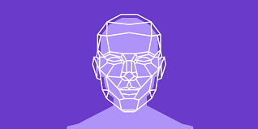
LIBRARIES AND FRAMEWORKS
GEOCODER
OPENCV
FACE RECOGNITION
FLASK

Slide 8
OPENCV
OpenCV, short for Open Source Computer Vision Library, is a widely-used open-source computer vision and machine learning software library.
Initially developed by Intel, it is now maintained by the OpenCV Foundation.
USAGE:
Image Processing Tasks: Plays an important role in the application's image processing pipeline. It performs various tasks, including face detection and encoding.
Face Detection: OpenCV provides pre-trained Haar cascades and deep learning-based models for detecting faces within images.
Encoding: OpenCV plays a crucial role in encoding faces.These encodings capture unique facial features, allowing for accurate recognition of individuals.
Image Manipulation:OpenCV facilitates image manipulation, such as resizing, cropping, and color space conversion.

Slide 9
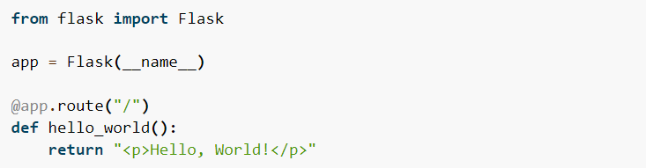
FLASK
Flask is a lightweight and extensible micro web framework for Python.
It provides a simple and flexible way to build web applications and APIs.
Flask routes map URLs to Python functions, enabling the handling of web requests.
Web requests trigger the execution of corresponding view functions, which can render templates, process form data, or return JSON responses.
Flask's routing system matches URLs to view functions using the @app.route() decorator.
Routes can include URL parameters and support different HTTP methods like GET, POST, etc.

Slide 10
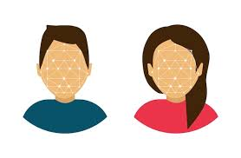
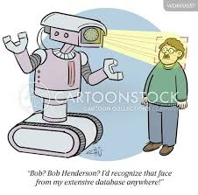
FACE_RECOGNITION
The face_recognition library is a popular Python package for face detection, recognition, and manipulation tasks.
It provides a simple yet powerful API for working with facial data in images and videos.
The face_recognition library is utilized for detecting faces within images or video frames.
It can also recognize and identify faces by comparing them with known faces in a database.
Key Functions:
face_encodings: This function computes a numerical encoding (or embedding) for a detected face, capturing its unique characteristics as a feature vector.
face_distance: This function calculates the Euclidean distance between face encodings, allowing for face comparison and recognition based on similarity.
The face_recognition library simplifies complex face detection and recognition tasks, empowering developers to create innovative applications with facial recognition capabilities.

Slide 11
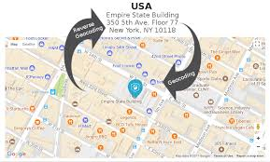
GEOCODER
Geocoding is the process of converting addresses into geographic coordinates (latitude and longitude), while geolocation is the estimation of a device's geographical location.
The geocoder library in Python provides a convenient interface for performing geocoding and reverse geocoding tasks.It supports multiple geocoding services, such as Google Maps API, OpenStreetMap Nominatim, and Bing Maps API.
The geocoder library can retrieve a user's geographic coordinates based on their IP address.
Geolocation plays a crucial role in verifying the user's location for attendance taking in applications such as employee attendance systems or virtual classrooms.
By comparing the user's geographic coordinates with predefined location boundaries, the system can determine whether the user is within the designated area for attendance.

Slide 12

APPROACH
Image Data Acquisition
ATTENDANCE MARKING
FACE DETECTION
FACE RECOGNITION
FACE ENCODING

Slide 13
WORKING
STEP 1:
When the capture button is clicked, a popup appears prompting the user to enter their name.
The processed frame, containing the detected face, is then sent to the Flask server along with the associated name.
Upon receiving the image data and name, the server decodes the image and utilizes the Haar cascade classifier for face detection.
If a face is detected, it is cropped from the image and stored, along with the associated name, for further use.
STEP 2:
The load_images function loads user images from a directory and extracts class names (filenames).
It then generates face encodings for each image using the findEncodings function.
findEncodings converts images to RGB format and encodes faces using the face_recognition library.
The encoded faces are stored for recognition purposes.
STEP 3:
To capture the attendance,the user clicks on the take_attendance button,the model then calculates the geolocation of the user using their IP address.Only if the user is within the mentioned radius of the mentioned location will the user be allowed to give their attendance.

Slide 14

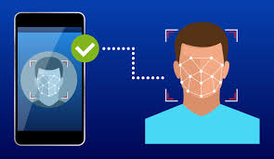
STEP-4:
The recognize_faces method decodes the image data received from the client.
It then preprocesses the image by resizing and converting it to RGB format.
Using the face_recognition library, it detects faces in the image and calculates their encodings.
These encodings are compared with the known encodings stored in encodeListKnown.
If a match is found based on a predefined threshold, the recognized face is marked for attendance.
STEP-5:
The model access the given path and records the attendance of the recognized person in the file.The attendance is stored in the format:”NAME-DATE-TIME”

Slide 15

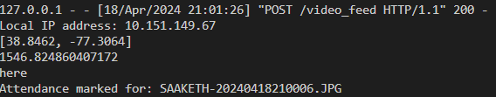

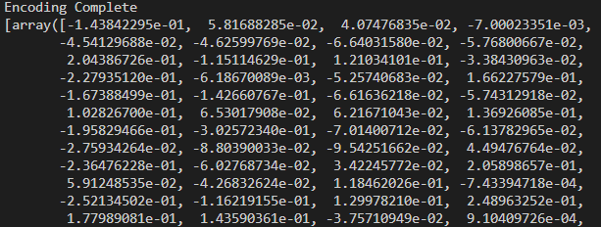
DEMO

Slide 16
THINGS TO LOOK OUT FOR …..
Benefits
Availability
Privacy
Case Study
security
Challenges

Slide 17
Security Considerations
Access control : Multi-factor authentication (MFA) adds an extra layer of security by requiring users to provide multiple forms of verification before accessing the system
Encryption of facial data:Utilize strong encryption techniques to secure facial data both in transit and at rest. Encryption helps prevent unauthorized access to sensitive information, ensuring that even if the data is intercepted, it remains unintelligible to unauthorized parties
Importance of data security and privacy
Benefits of Facial Attendance
Improved security posture
Increased accuracy in attendance tracking
Time and cost savings
Enhanced user experience for employees

Slide 18
Challenges and Limitations
Privacy concerns :Facial recognition technology presents substantial privacy concerns because it collects and processes biometric data, which is inherently personal and sensitive.Individuals may be concerned about how their facial data is gathered, stored, and used, which could lead to employee reluctance or pushback.
Accuracy issues :Despite advances in facial recognition technology, accuracy concerns persist, especially in situations including low illumination, occlusions, or variances in facial expressions.False positives and false negatives can occur, resulting in individuals being wrongly identified or denied access.
Ethical considerations :Facial recognition algorithms may be biased depending on race, gender, or age, resulting in discriminatory consequences.Organizations must address these ethical concerns and put in place procedures to reduce bias and assure fairness and equity when using facial attendance systems.
Case Studies
Corporate offices
Government agencies
Educational institutions

Slide 19
Conclusion
Future Trends
1
Ai-powered facial analysis
2
Multi-factor authentication
3
Integration with other security system

Slide 20
Thank you
Any Question ?

